Slide 1
Simple grid-based model of sandpile avalanche due to heating process
S. Viridi^{1,}*, Z. F. T. W. Lestari², T. D. K. Wungu³, Suprijadi⁴
¹⁻⁴Departemen of Physics, Faculty of Mathematics and Natural Sciences
^{1,3-4}Research Center for Nanosciences and Nanotechnology
Institut Teknologi Bandung, Jalan Ganesha 10, Bandung 40132, Indonesia
^{1,}*dudung@gmail.com, ²firdauszahrotul@gmail.com, ³triati@fi.itb.ac.id, ⁴supri@fi.itb.ac.id
30 June 2018 Kanazawa, Japan
IWCS 2018

Slide 2
Outline
Introduction
Experiment
Model
Results and discussion
Summaries
30 June 2018 Kanazawa, Japan
IWCS 2018

Slide 3
Introduction
30 June 2018 Kanazawa, Japan
IWCS 2018

Slide 4
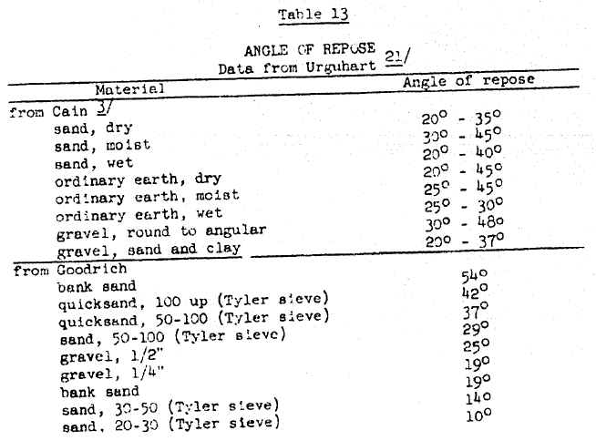

Angle of repose
AC Carter 1950 HYD-299 Angle of Repose of Non-Cohesive Material.
30 June 2018 Kanazawa, Japan
IWCS 2018

Slide 5
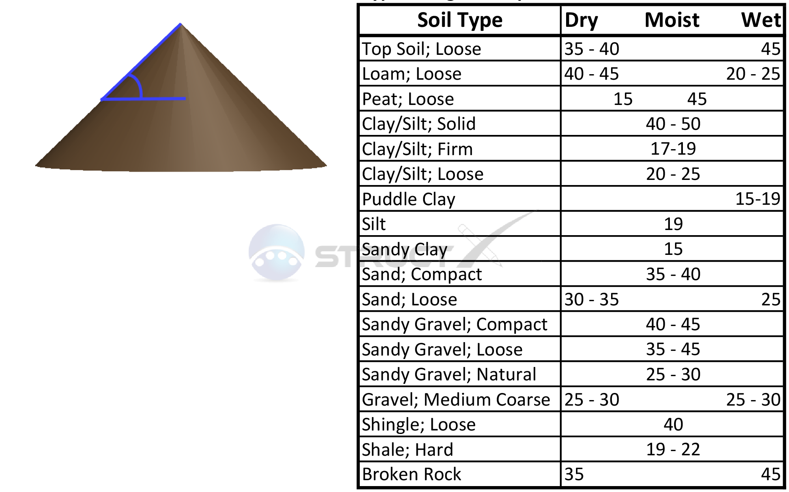
Its typical value
URL http://structx.com/Soil_Properties_005.html [20180627].
30 June 2018 Kanazawa, Japan
IWCS 2018

Slide 6
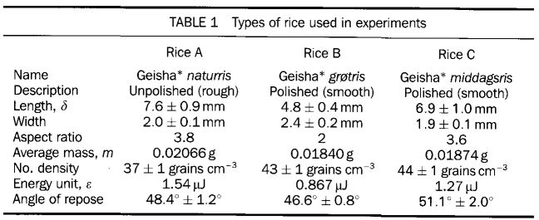
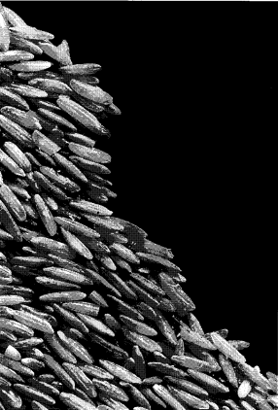
Angle of repose (of rice)
V Frette, K Christensen, A Malthe-Sørenssen, J Feder, T Jøssang, P Meakin 1996 Nature 379 49.
30 June 2018 Kanazawa, Japan
IWCS 2018

Slide 7
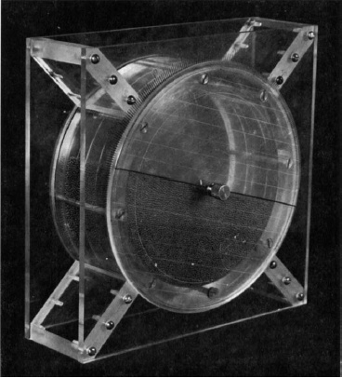
Measuring angle of repose
A rotating-drum can be
used to measure
  critical angle of
  repose θ_{C}
  angle of rest θ_{R}
MA Carrigy 1970 Sedimentology 14 147.
30 June 2018 Kanazawa, Japan
IWCS 2018

Slide 8
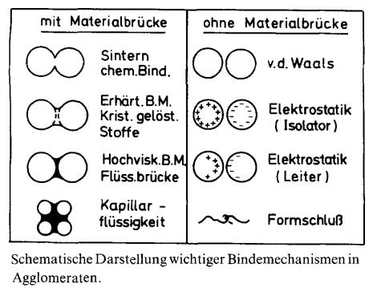
Type of bonds
H Schubert 1979 Chem. Ing. Tech. 51 266.
30 June 2018 Kanazawa, Japan
IWCS 2018

Slide 9
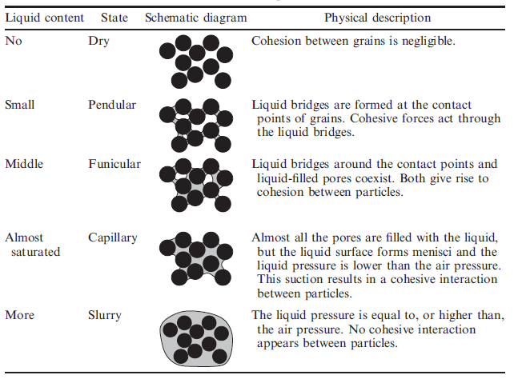
Liquid-bridge bond
N Mitarai, F Nori 2006 Adv. Phys. 55 1.
30 June 2018 Kanazawa, Japan
IWCS 2018

Slide 10
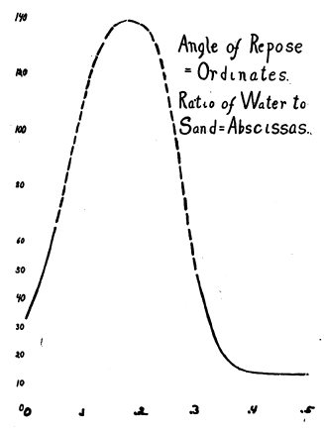
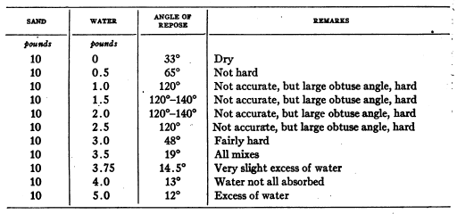
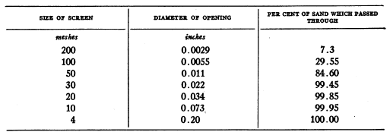
Maximum angle and water content
AG Webster 1919 PNAS 5 263.
30 June 2018 Kanazawa, Japan
IWCS 2018

Slide 11
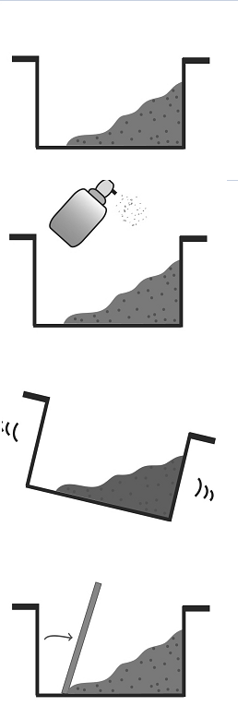
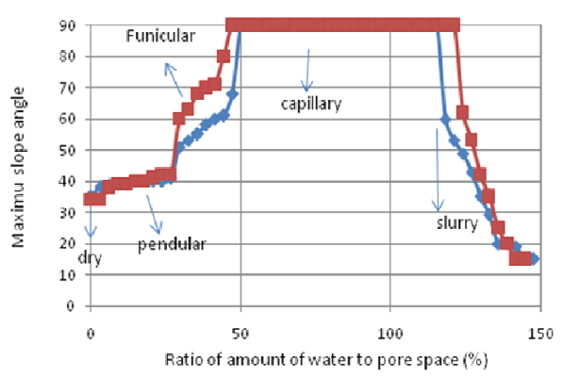
Max.. angle .. water content (cont.)
U Fauzi, S Viridi, Q Ghaisani 2010 AIP Conf. Proc. 1325 124.
30 June 2018 Kanazawa, Japan
IWCS 2018

Slide 12
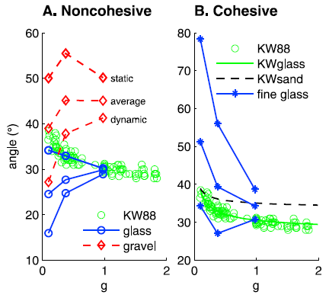
Dependence on gravity
MG Kleinhans, H Markies, SJ de Vet, AC in't Veld, FN Postema 2011 J Geophys. Res. 116 E11004.
30 June 2018 Kanazawa, Japan
IWCS 2018

Slide 13
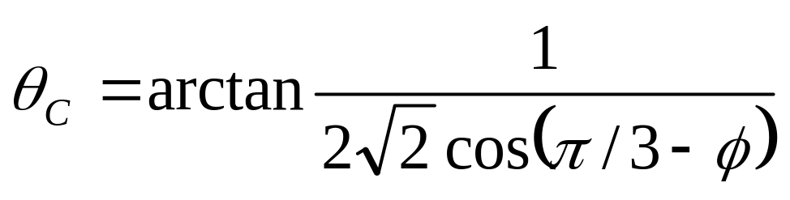
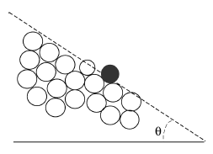
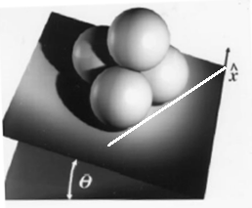
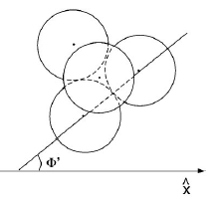
Critical angle (of dry sphere)
Maximum angle of repose for smooth sphere
θ_{C,3D} ~ 23.4 °
θ_{C,2D} ~ 30 °
R Albert, I Albert, D Hornbaker, P Schifffer, A-L Barabási, 1997 Phys. Rev. E 56 R6271.
30 June 2018 Kanazawa, Japan
IWCS 2018

Slide 14
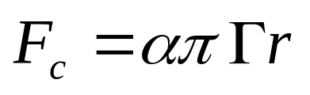
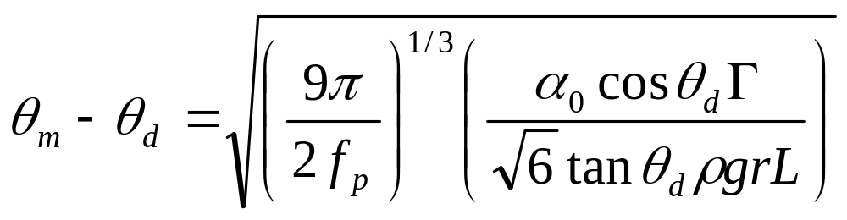
Wet granular pile
Capillary force due to liquid-bridge bond
Relation between maximum angle while wet θ_{m} and dry θ_{d} is
S Nowak, A Samadani, A Kudrolli 2005 Nat. Phys. 1 50.
30 June 2018 Kanazawa, Japan
IWCS 2018
Notes:
\alpha dimensionless constant ~ size and shape of liquid-bridge ~ 1 (ambiguity), \Gamma = 5 for r = 0.5 mm mixed with Si-oil, fp packing fraction ~ 0.64 for spherical grains,

Slide 15
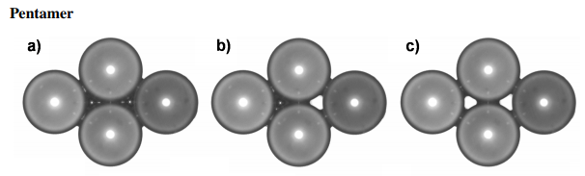
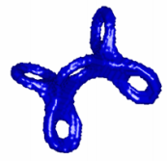
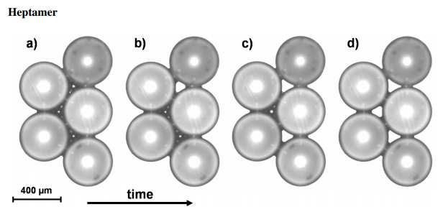
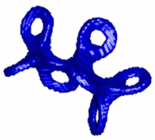
Evolving complex liquid-bridge
M Scheel 2009 PhD Thesis Georg-August-Universität Göttingen, Germany.
30 June 2018 Kanazawa, Japan
IWCS 2018

Slide 16
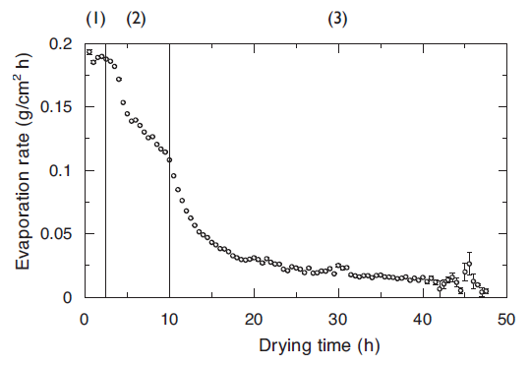
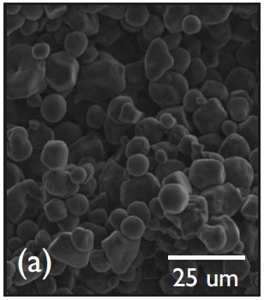
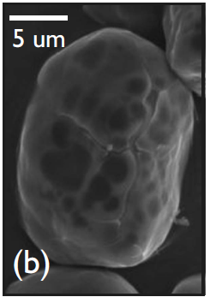
Not-constant evaporation rate
Starch: (1) surface evaporation, (2) surface evaporation help by capillary transport, (3) vapor transport through space between grains
L Goehring 2009 Phys. Rev. E 80 036116.
30 June 2018 Kanazawa, Japan
IWCS 2018

Slide 17
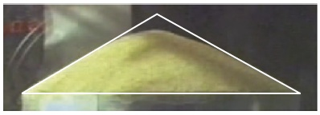

Angle of repose of a granular pile
Experiment
Discrete element method
H Nakashima, Y Shioji, T Kobayashi, S Aoki, H Shimizu, J Miyasaka, K Ohdoi 2011 J. Terramechanics 48 17.
30 June 2018 Kanazawa, Japan
IWCS 2018

Slide 18
Experiment
30 June 2018 Kanazawa, Japan
IWCS 2018

Slide 19
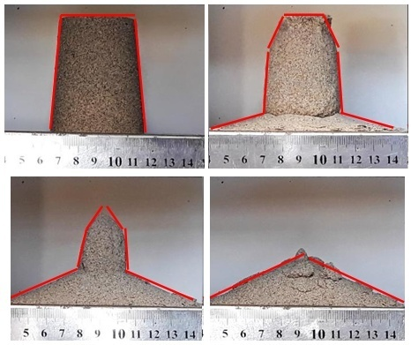
Drying a sand castle
A cup of sand
+ 20 ml water
heated in oven
with 150 °C
Observed at
0, 30, 60, and
90 minutes
30 June 2018 Kanazawa, Japan
IWCS 2018

Slide 20
Hypothesis
It dries layer per layer from outside to inside (as seen in the observation)
Different maximum angle of repose in each layer (dry and wet granular pile)
Evaporation rate is also not constant according previous reported study
Isotropic behaviour is assumed
30 June 2018 Kanazawa, Japan
IWCS 2018

Slide 21
Model
30 June 2018 Kanazawa, Japan
IWCS 2018

Slide 22
Grid-based system
One particle is represented by one cell in grid system
Particle can move to another grid if destination grid is empty
“Probability” in each direction is different and can be chosen (p←, p→, p↑, p↓) (type of double)
30 June 2018 Kanazawa, Japan
IWCS 2018

Slide 23
Random movement
L ∈ [0, 1] (type of int)
N_{dir} = 8
Δx ∈ [p← × N_{dir}, p→ × N_{dir}] (type of int)
Δy ∈ [p↑ × N_{dir}, p↓ × N_{dir}] (type of int)
src[i, j] ➔ dest[i’, j’] if(src == 1 && dest == 0)
i' = i + L Δx
j' = j + L Δy
30 June 2018 Kanazawa, Japan
IWCS 2018

Slide 24
Results and discussion
30 June 2018 Kanazawa, Japan
IWCS 2018

Slide 25
Parameters
System grid (L_{x} × L_{y}) = 300 × 300
Object grid (H × W) = 100 × 200
Δt = 1, T_{data} = 100
t_{beg} = 0, t_{end} = 10⁴
Normalized: t → (t – t_{beg}) / (t_{end} – t_{beg}) ∈ [0, 1]
p←, p→, p↑, p↓ (phase dependence)
30 June 2018 Kanazawa, Japan
IWCS 2018

Slide 26

Initial condition
System grid (square with blue line) with object grid (black rectangle)
30 June 2018 Kanazawa, Japan
IWCS 2018

Slide 27
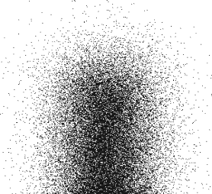
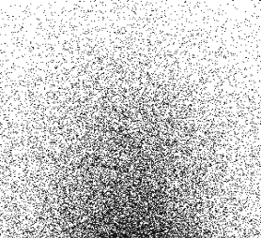

Gas phase
p← = –1, p→ = +1
p↑ = +1, p↓ = –1
t = 0.01
t = 0.04
t = 0.2
30 June 2018 Kanazawa, Japan
IWCS 2018

Slide 28
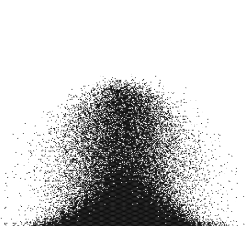


Fluid phase
p← = –1, p→ = +1
p↑ = +0.5, p↓ = –1
t = 0.01
t = 0.1
t = 0.2
30 June 2018 Kanazawa, Japan
IWCS 2018

Slide 29
Solid phase
p← = 0, p→ = 0
p↑ = 0, p↓ = 0
t = 0
t = 0.5
t = 1
30 June 2018 Kanazawa, Japan
IWCS 2018

Slide 30
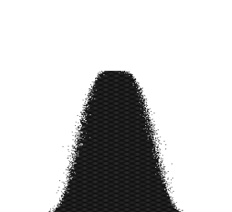
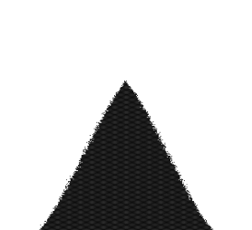
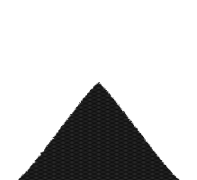
Granular phase
p← = –0.5, p→ = +0.5
p↑ = –0.5, p↓ = –1
t = 0.01
t = 0.06
t = 0.3
30 June 2018 Kanazawa, Japan
IWCS 2018

Slide 31
Nonuniform evaporation rate
p← = –0.5, p→ = +0.5, p↑ = 0, p↓ = –1 (granular)
p← = 0, p→ = 0, p↑ = 0, p↓ = 0 (solid)
T_{data} = 10, T_{dry} = 500, L_{dry} = 10 (particle)
dry layer of thickness L_{dry} is introduced every T_{dry} period of time → act as granular phase, and the rest is still in solid phase
Observed for t = 0.001, 0.041, 0.054, 0.092, 0.104, 0.144, 0.206, 0.401
30 June 2018 Kanazawa, Japan
IWCS 2018

Slide 32
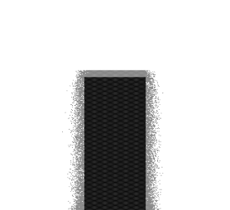
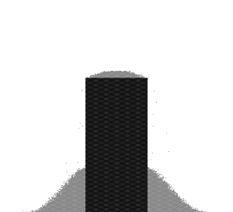
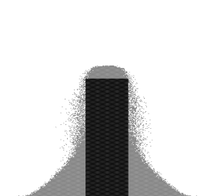
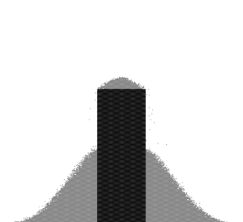
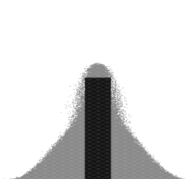
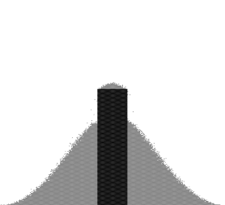
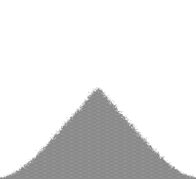
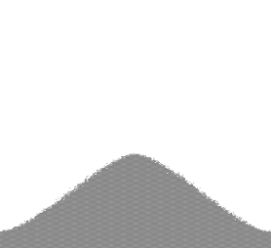
Nonuniform evaporation .. (cont.)
t = 0.001
t = 0.041
t = 0.054
t = 0.092
t = 0.104
t = 0.144
t = 0.206
t = 0.401
30 June 2018 Kanazawa, Japan
IWCS 2018

Slide 33
Summaries
30 June 2018 Kanazawa, Japan
IWCS 2018

Slide 34
Summaries
Grid-based model to simulate process of evaporation, fluidization, and granularization of a pile of solid has been constructed
Phase state simply depends on particles “probability” to move in certain direction
(p←, p→, p↑, p↓)
In order to mimic experimental result, evolv-ing dry layer must be introduced to the system
30 June 2018 Kanazawa, Japan
IWCS 2018

Slide 35
Future plan
Relating value of (p←, p→, p↑, p↓) to the physical process as evaporation and local water content in the system
Enhancing the code sasbgm, which based on butiran https://github.com/dudung/butiran
30 June 2018 Kanazawa, Japan
IWCS 2018

Slide 36
Acknowledgements
Kemenristekdikti grant in supporting this work
Prof. Morikawa at Osaka University in providing working place during the visit
Kanazawa University and the IWCS 2018 for facilitating presentation of the results
30 June 2018 Kanazawa, Japan
IWCS 2018

Slide 37
https://osf.io/nker6/
30 June 2018 Kanazawa, Japan
IWCS 2018

Slide 38
Thank you
30 June 2018 Kanazawa, Japan
IWCS 2018

